Slide 1
The Use of Inertial Forces for Propulsion of Wheeled Robots
By
Assoc. Prof. Ivan A. Loukanov
Department of Mechanical Engineering
Faculty of Engineering & Technology
University of Botswana
Private Bag 0061, Gaborone, Botswana

Slide 2
1. Introduction & Background
For many decades’ researches and enthusiasts from all over the world made remarkable attempts to create devices that can defy the Newton’s Laws.
The most famous of the mechanisms, called Inercoids are invented by the following authors:
Norman Dean (1959),
Robert Cook (1980), USA,
Roy Thornson 1990, Canada
Vladimir Tolchin (1977), Russia
Gennady Shipov (2006), Russia,
Christopher Provatidis (2010), Greece

Slide 3
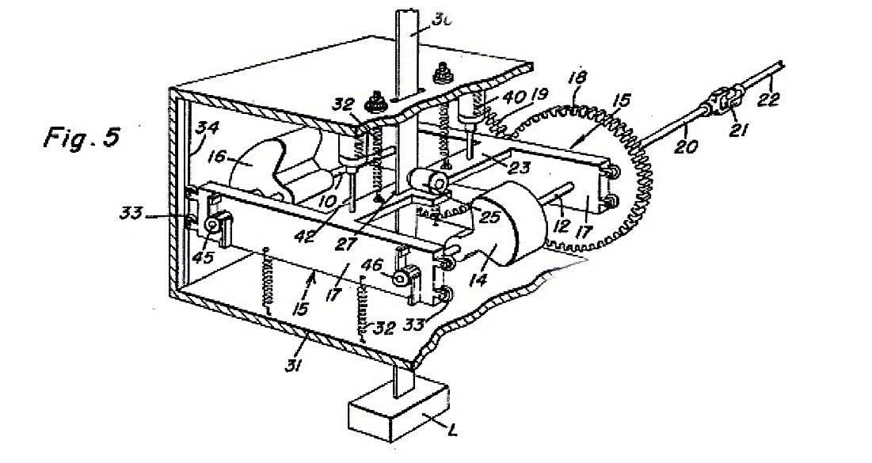
Dean’s 3D Inertial Drive System (US)
10, 12 – shafts of the
14, 16 – rotating masses
15, 17 – oscillating carrier
18, 19 – synchronizing gears
20, 22 – input driving shaft
25 – one-way friction clutch
30 – supporting column
31 – assemblage housing
32 – tension springs
33, 34 – guiding rollers and rails
40, 42 – electromagnetic actuators
45, 46 – micro-electrical switches
Fig. 1 Dean’s Inertial drive, 1959: US Patent # 2,886,976

Slide 4
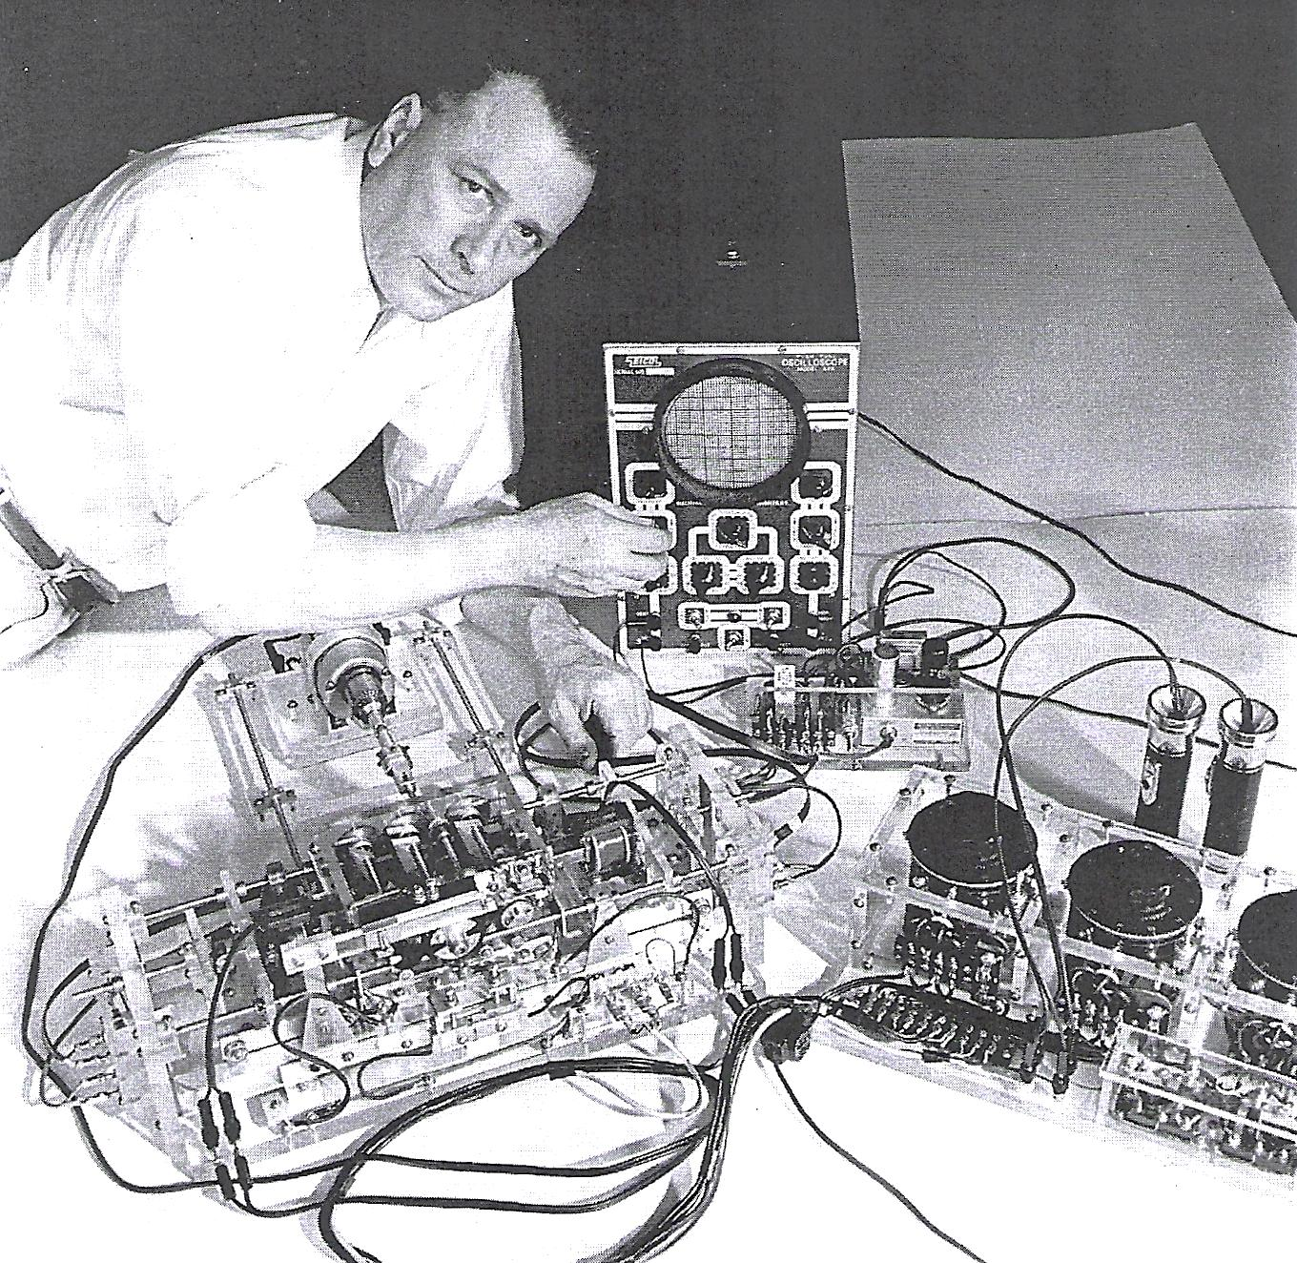
Dean’s 3D Inertial Drive System, (US)
Fig. 2 shows Norman Dean working and making a fine-tuning of his electro-mechanical inertial system.
Viewers may acknowledge the complexity of the drive, which is hard to understand how it works.

Slide 5
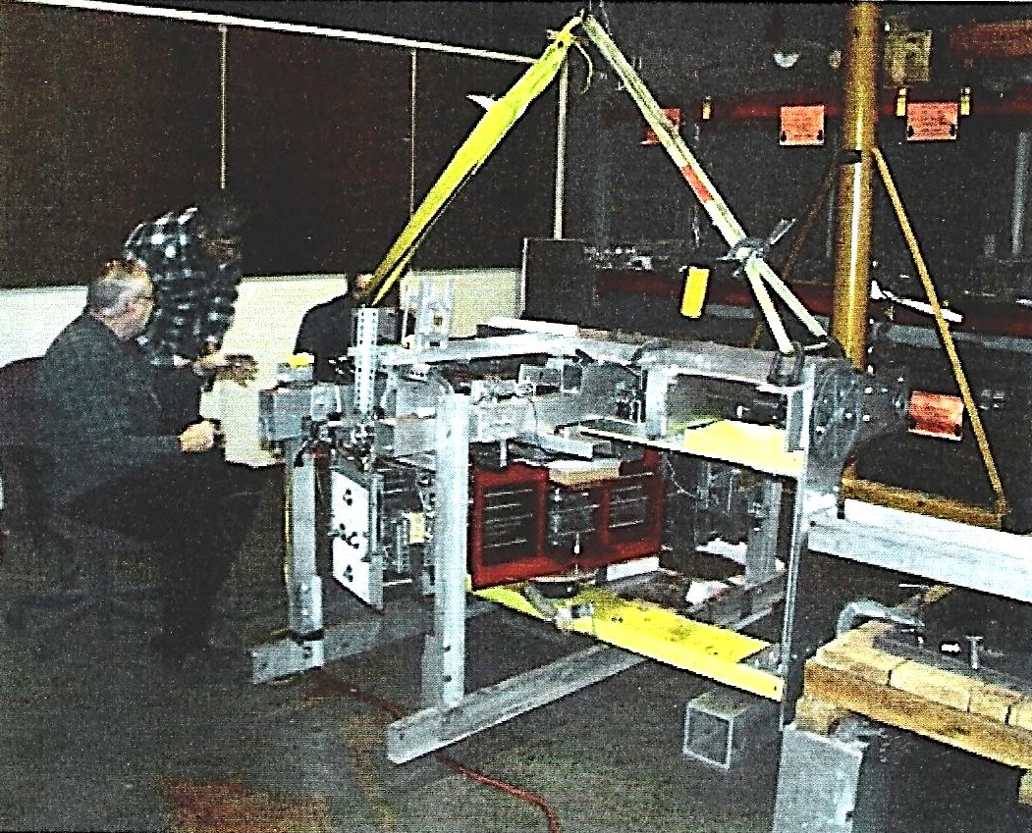
The Cook’s “CIP” Engine, USP # 4238968
Fig. 2 R. Cook CIP engine. Mass 127 kg, thrust force 35 N

Slide 6
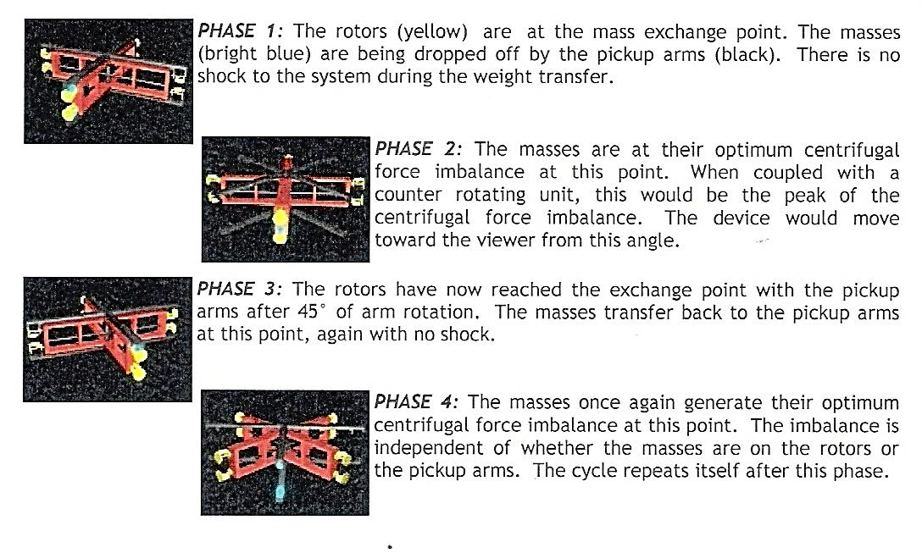
Cook’s Inertial Propulsion Engine, (US)
Fig. 3 Animation of CIP Engine; US Patent # 4238968

Slide 7
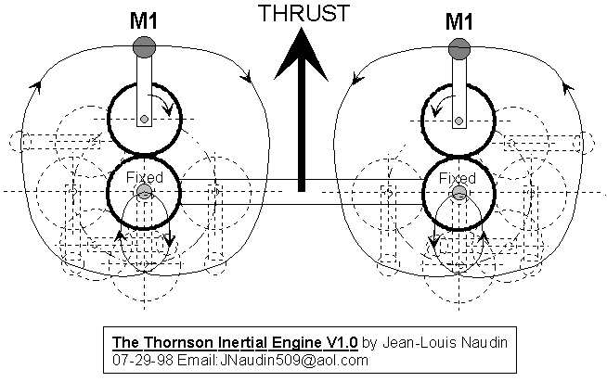
Thornson Inertial Drive (Canada)
The Thornson drive (1986) consists of two counter-rotating epicycle mechanisms of masses 2 × M1.
“Apparatus for developing a propulsion force US Patent # 4631971”
Fig. 3 Thornson Inertial Propulsion Drive

Slide 8
Tolchin Inertial Drive (Russia)
A careful survey reveals that Russian scientists had earlier started and systematically conducted a relevant research on inertial drives, which remains alive even today: Tolchin (1977), Cherepanov (1996), Shipov (2006), and many others.
Rotating
masses
Motor
break
M1
Spring
motor
M2
Fig. 4 Tolchin inertia drive, Mass 1.5 kg, thrust force 8 N

Slide 9
Shipov Inertial Drive (Russia)
Servo motor
Computer
Rotation
sensors
Chasses
Motion
sensors
Rotating
masses, m= 2×1.0 kg
Fig. 5 Shipov drive, Mass1.8 kg, thrust force 150 N

Slide 10
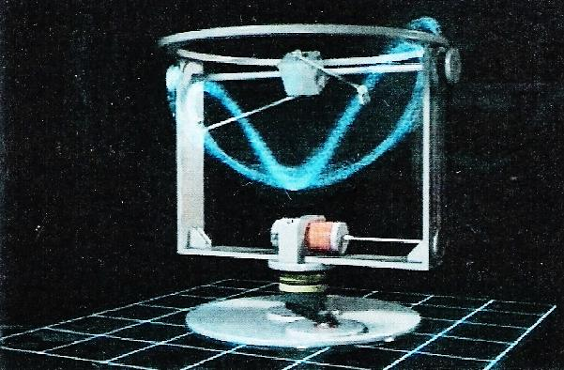
Provatidis Inertial Drive (Greece)
ω_{y}
ω_{x}
Rotating masses 20 gr, each
Motor #1
ω_{z}
Motor #2
Fig. 6 The drive creates a Net Impulse by means of figure-eight-form paths of rotating masses; Total mass of 22 kg and producing vertical thrust of 18 N

Slide 11
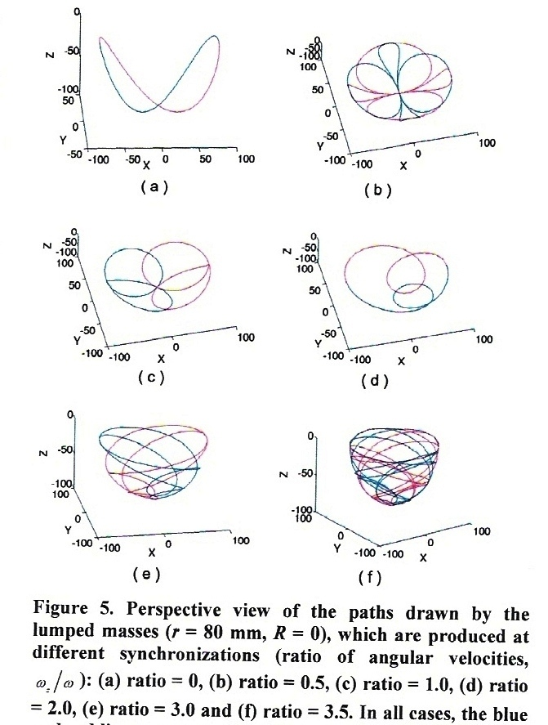
Provatidis Inertial Drive (Greece)
ω_{z} = 0
ω_{z}
ω_{z}
ω_{z}
Fig. 7 The paths of rotating masses when ω_{z} is added

Slide 12
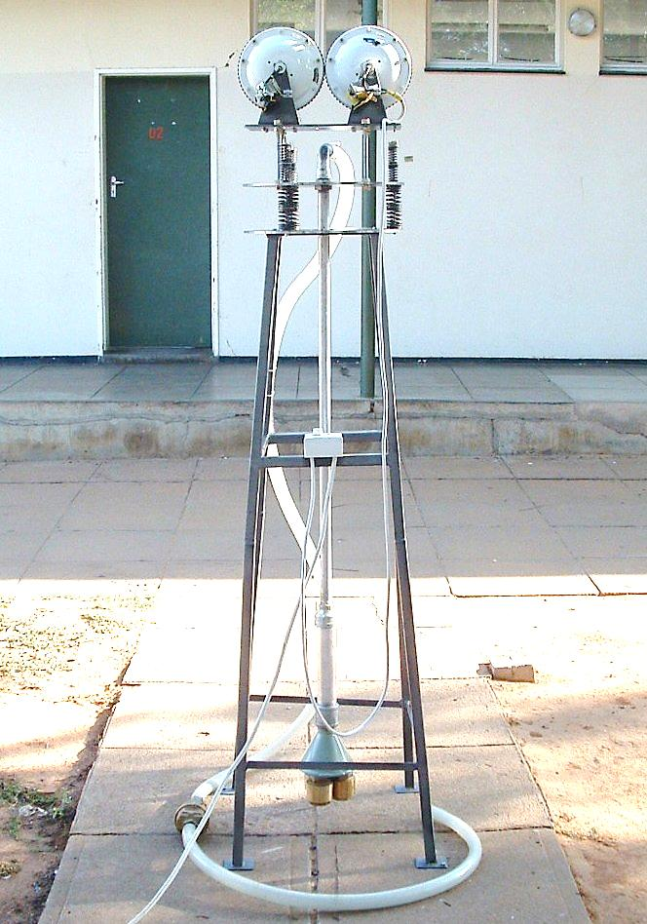
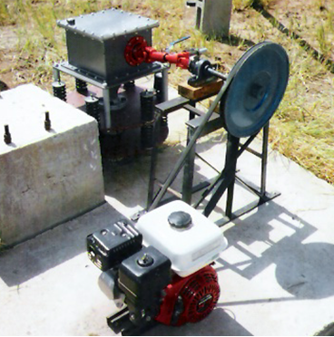
Inertial-driven Water Pumps (Botswana)
Fig. 8 The model #1 inertial pump
Fig. 9 The set up of second prototype of inertial pump, DAR Sebele, Botswana

Slide 13
Inertia Propulsion of Mobile Robots
Considering the problems encountered in most inertial drives and the skills obtained with inertial pumps, a new propulsion, system using the modified Dean drive, was designed, built and successfully tested.
Since the proposed inertial drive is a novel system for propulsion a detailed design and principle of operation is provided.
Fig. 10 illustrates the physical model of the drive:
1 – is the chasses (outer frame)
2 – carrier (inner frame)
3 – rotating eccentrically mounted masses
4 - the wheels with one-way-bearings.

Slide 14
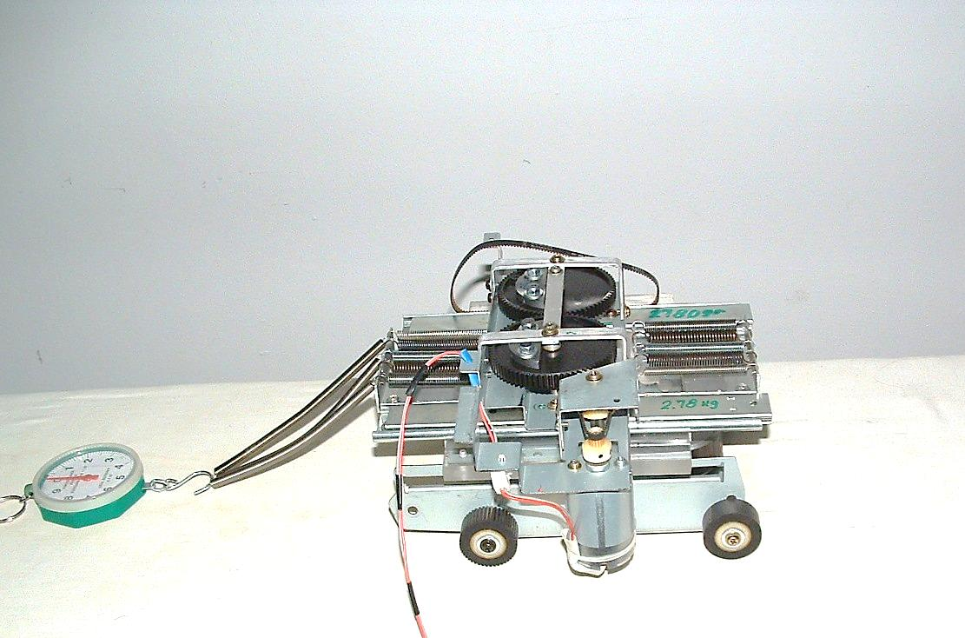
First Inertia Driven Prototype
1 – outer frame (chassis)
2 – rotating eccentric masses
3 – inner frame
4 – one-way rotating wheels
5 – a DC motor
6 – springs suspension system
7 – auxiliary springs
8 – spring dynamometer
9 – linear bearings
2
3
6
8
7
9
1
4
5
4
Fig. 9 The conceptual model of the I ^{st} prototype Robot

Slide 15
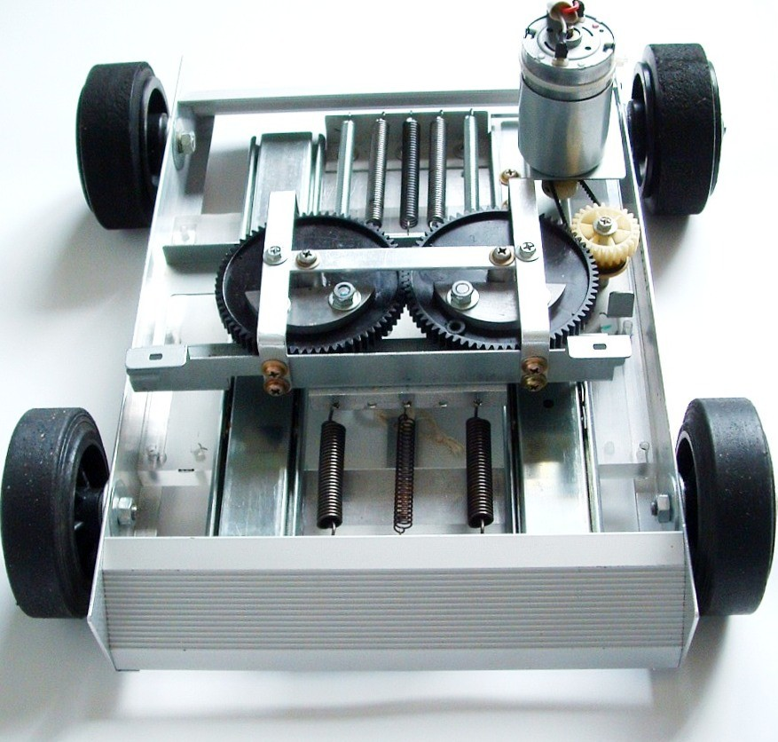
Physical Model of a Mobile Robot propelled by an Inertial Drive (BG)
5 – DC motor
4
4 – one-way
bearing
3 – rotating
masses
2 – carrier
4
6 – spring
system
1 – chassis
Direction of Motion
Fig. 10 Front view of the Second prototype Robot

Slide 16
Mechanical Model of the Robot
Fig. 11a 3D-dynamic model of a Robot propulsion

Slide 17
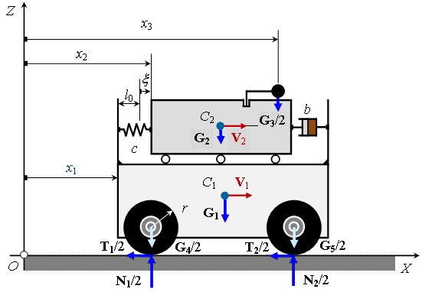
The 3D-Model in the X-Z Plane
m₃
m₂
b
k
m₁
Fig. 11b 3D-dynamic model of a Robot propulsion

Slide 18
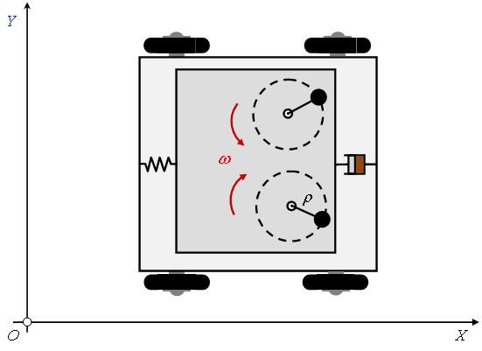
3D-Model in the X-Y Plane
x₃
x₂
m₃
x₁
b
k
m₃
m₂
m₁
Fig. 12 3D-dynamic model of the Robot, top View in x-y plane

Slide 19
Parameters of the Dynamic Model:
m_{1,} m₂ - mass of the chassis & carrier [kg]
2m₃ - total mass of rotating masses, [kg]
ρ - eccentricity of the rotating masses, [m]
mρ - rotating unbalance of the shaker, [kg.m]
b - damping coefficient of springs, [N.s/m]
k - resultant stiffness of the springs, [N/m]
ω - angular velocity of masses – m₃, [rad/s]
x1, 2, 3 - displacement of the chassis, carrier and rotating masses, [m]
t - time, [s]

Slide 20
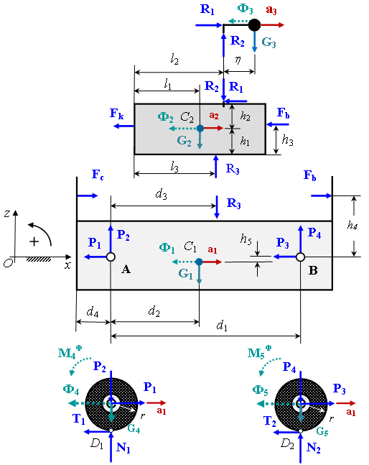
Fig. 13. Free-Body Diagram of the Robot

Slide 21
Equations of Reactions
R₁ = m₃a₃ = m₃(a₂ – ω ²η). (1)
R₂ = m₃g (2)
R₃ = (m₂ + m₃)g (3)
P₁ = (3/2)m₄a₁ (4)
P₂ ={–[k(x₂–x₁–l₀)+b|V₂– V₁|σ] h₄+(m₂ + m₃)g (d₁ – d₃) + m₁g(d₁ – d₂) – m₁a₁h₅}/d₁ (5)
P₃ = (3/2)m₅a₁ (6)
P₄ ={[k(x₂– x₁ – l₀) + b|V₂ – V₁|σ]h₄ + (m₂ + m₃)g d₃ + m₁gd₂ + m₁a₁h₅}/d₁ (7)
N₁ = m₄ g + {– [k(x₂ – x₁ – l₀) + b|V₂ – V₁|σ]h₄ + (8)
+ (m₂ + m₃)g(d₁ – d₃) + m₁g(d₁ – d₂) – m₁a₁h₅}/d₁

Slide 22
Equations of Reactions & Accelerations
N₂ = m₅g + {[k(x₂ – x₁ – l₀) + b|V₂ – V₁|σ]h₄ +
(m₂ + m₃)gd₃ + m₁gd₂ + m₁a₁h₅}/d₁ (9)
T₁= (1/2)m₄[k(x₂–x₁–l₀)+b|V₂–
V₁|σ]/[m₁ + (3/2)(m₄ + m₅)] (10)
T₂= (1/2)m₅[k(x₂–x₁–l₀)+b|V₂–
V₁|σ]/[m₁ + (3/2)(m₄ + m₅)] (11)
a₁ =[k(x₂ – x₁ – l₀) + b|V₂ – V₁|σ]/[m₁ +(3/2)(m₄ + m₅)]
a₂ =[m₃ω ²η–k(x₂–x₁–l₀)–b|V₂–V₁|σ]/(m₂ + m₃) (12)
To avoid separation between the wheels & ground
the Eq. 13 must hold → min _{t} {N₁(t), N₂(t)} > 0 (13)

Slide 23
Preventing Backward Motion
A backward motion of the wheels occurs when V₁(t) < 0.
This situation is simulated at any time t by the substitution:
V₁ = V₁(t) when V₁(t) > 0, and
V₁ = 0, when V₁(t) ≤ 0 (14)
To prevent backward motion of the wheels, special one-way needle bearings are installed in the hub of each wheel. The bearing allow rotation in one direction and prevent rotation in the opposite one.

Slide 24
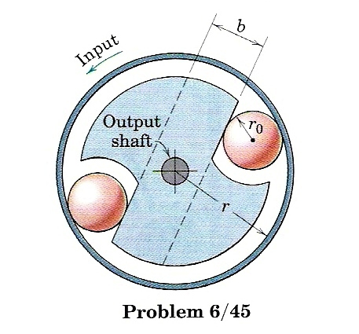
One-way- Ball (Roller) Bearing
No rotation
Free
rotation
Fixed
shaft
Fig. 14 shows the image of an one-way-bearing
mounted in the wheel’s hubs.

Slide 25
Fig. 15 displays the graphical interpretation of the impulse of transmitted force F_{T}(t) where the period T and the positive and negative waves of the impulse I_{FT}(t) are seen
Fig. 15 illustrates the “sin” shape of the impulse of F_{T}(t)

Slide 26
Apparently the total impulse of the transmitted force per cycle of oscillation is zero. So there will be no change in the momentum and hence no unidirectional motion will be made. This will result in a forward & backward motion of the system, corresponding to the positive and negative halves of the impulse respectively.
To resolve this problem and achieve a forward motion it is apparent that the negative half of the transmitted force F_{T}(t) has to be removed.

Slide 27
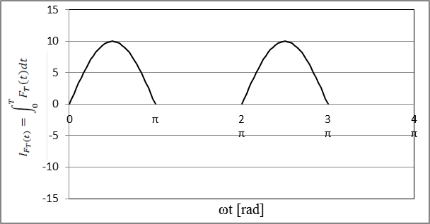
Special one-way-bearings are used to eliminate the effect of negative impulses. As a result the graph of I F_{T} (t) becomes as shown in Fig. 16.
T
Fig. 16 displays the positive impulses of the force F_{T}(t).

Slide 28
Differential Equations of Motion
Differential equations governing the motion are:
dx₁/dt = V₁, x₁(0) = 0, (15)
dV₁/dt = [kx₂ – x₁ – l₀) + b|V₂ – V₁|σ] / [m₁ + (3/2)(m₄ + m₅)], V₁(0) = 0, (16)
x₂/dt = V₂, x₂(0) = s₀, (17)
dV₂/dt = m₃ω ₂ρ sin(ω t + ϕ₀) – k(x₂ – x₁ – l₀) – b|V₂ – V₁|σ] / (m₂ + m₃), V₂(0) = 0, (18)
where
V₁ = V₁(t), when V₁(t) > 0,
V₁ = 0, when V₁(t) ≤ 0. (19)
The above equations have sense if the following inequality holds: min _{t} {N₁(t), N₂(t)} > 0 (20)

Slide 29
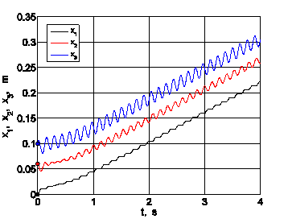
Results from the Numerical Experiments
Fig. 17 illustrates the numerical results for V_{1,2,3}(t); a₁,_{2,} ₃(t); V₁(x₁)

Slide 30
Results from the Numerical Experiments
Fig. 18 explains the num. results for P_{1,2}(t); P_{3,4}(t); T_{1,2}(t); N_{1,2}(t)

Slide 31
Results from the Numerical Experiments
Fig. 19 shows the num. results for V₁(k); V₁(t); V₁(b); V₁(ᵠ_{o})

Slide 32
Results from the Numerical Experiments
Fig. 20 The velocity of Chassis ⟨ V₁(ω, k) ⟩

Slide 33
Results from the Numerical Experiments
Fig. 21 Velocity of the Robot Chassis 1, ⟨ V₁(S₀, φ₀) ⟩

Slide 34
Results from the Numerical Experiments
Fig. 21 Velocity of the Robot Chassis 1, ⟨ V₁(k, φ₀) ⟩

Slide 35
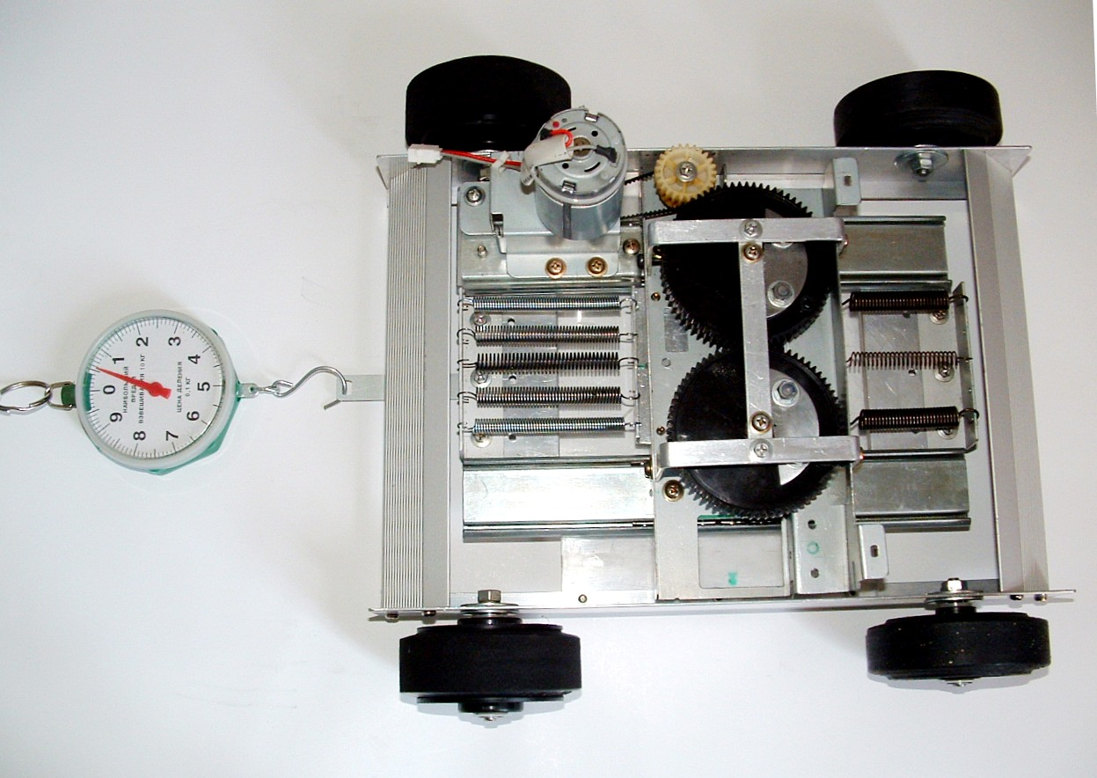
Top View of Inertial Driven Robot
8
1
6
7
5
6
5
1 – outer frame
2 – inner frame
3 – rotating masses
4 – one-way bearings
5 – spring system
6 – wheels
7 – a DC motor
8 – spring dynamometer
4
3
2
4
Fig. 22 Determining the towing force of the robot

Slide 36
Tests were conducted with the prototype robot and a forward motion is documented although in a pulsing style. The latter refers to the pulsing nature of the transmitted force. When the frequency of excitation increases the motion of the robot becomes smooth and steady.
A towing force ranging from 0 to 8.0 [N] was measured, depending upon:
the magnitude of rotating unbalance mρ,
oscillating mass m₂,
resonance frequency f,
coefficient of static friction μ_{s}
the total mass M_{T} of the prototype.

Slide 37
Measuring Set Up for the Robot Experiments
Fig. 23 1 - the shaker, 2 Data Log system, 3 – External power
source, 4 – motor speed controller, 5 -accelerometer

Slide 38
Table 2 Experimental results for M = 1.310 kg

Slide 39
Conclusions
The numerical results of the suggested model revealed strong sensitivity of the mean velocity V₁ to the pre-tension of the equivalent spring, So, to the initial phase angle of the rotating masses φ₀, and dissipation of energy (b) in the mechanical systems.
The passive nature of driving wheels ensured rolling of wheels without sliding over planes of different surface roughness.
The resonance regime of vibration propulsion is the most appropriate to attain maximal mean velocity of the robot, but it is accompanied with great dynamic stresses in mechanical components of the system.

Slide 40
Conclusions
4. The proposed propulsion system does not defy Newton laws and the principle of momentum since it uses friction forces between the wheels and the ground.
5. The motion is due to inertial forces and because of one-way bearings.
It is obvious that the motion of such a vehicle does not require any transmission devices such as clutches, gearboxes, prop shafts, differentials, etc.
The inertial drive is simple, cheap and easy to maintain propulsion system as compared to any other vehicle in use today e.g. cars, lorries, tractors, etc.

Slide 41
Conclusions
8. Possible areas of technical applications of the proposed drive may include:
As a supplementary drive in earthmoving vehicles such as wheeled and track tractors, where the low speed is predominant but the traction capacity is important.
Special robots to be used in the Nuclear and Chemical Industry.
For Military application in detecting and destroying land mines, unexploded shells etc.
Under water application in see and ocean exploration etc.

Slide 42
References
Bodine, 1951. Deep well pump, USP # 2553542
2. Cook R.L., 1980. Inertial propulsion, USP # 4238968.
3. Cherepanov A.A. 1996. Inertial propulsion of vehicle, Russian Patent # 2066398
4. Dean N.L., 1959. System for converting rotary motion into unidirectional motion, US Patent # 2,886,976.
5. Loukanov I. A., 2015. Vibration Propulsion of a Mobile Robot. IOSR Journal of Mechanical and Civil Engineering (IOSR-JMCE) e-ISSN: 2278-1684,p-ISSN: 2320-334X, Volume 12, Issue 2 Version II, pp. 23-33, www.iosrjournals.org

Slide 43
References
7. Loukanov I. A., 2014. Application of Inertial Forces for generating Unidirectional Motion, Proceedings of the Scientific Conference of University of Rousse, 2014, Vol. 53, Series 2.
8. Provatidis C.G., 2010. Some Issues On Inertia Propulsion Mechanisms Using Two Contra-Rotating Masses, Theory of Mechanisms & Machines, 1 (8): 34-41, (http://tmm.spbstu.ru).
9. Provatidis C.G., 2010. A device that can produce Net Impulse using rotating masses. Engineering, pp. 648-657; Published Online Aug. 2010 (http://www.SciRP.org/journal/eng).
7. Shipov G., 2006. Inertial propulsion in Russia, Available at: American Antigravity. Com

Slide 44
Thank You

